Slide 1
Variational Auto-Encoder - II
Lecture 9
Part 2
Generative AI for Computer Vision

Slide 2
Content
Variational Inference
Evidence Lower Bound (ELBO)
VAE objective Function
VAE Loss Function
ELBO and posterior approximation
The Reparameterization Trick
Vision Applications

Slide 3

Variational Auto-encoder
Problem Formulation
We have:
  Latent variable $z$
  Observed data $x$
  Generative Model: $p_{θ}\left(x,z\right)=p_{θ}\left(x | z\right)p(z)$
We want to maximize: $p_{θ}\left(x\right)$

Slide 4
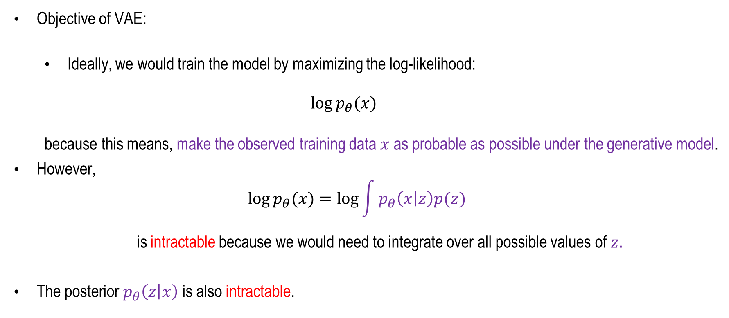
Variational Inference
Objective of VAE:
  Ideally, we would train the model by maximizing the log-likelihood:
  $$\log{p_{θ}(x)}$$
  because this means, make the observed training data $x$ as probable as possible under the generative model.
However,
$$\log{p_{θ}(x)}=\log{\int{p_{θ}\left(x | z\right)p(z) }}$$
is intractable because we would need to integrate over all possible values of $z.$
The posterior $p_{θ}\left(z | x\right)$ is also intractable.

Slide 5



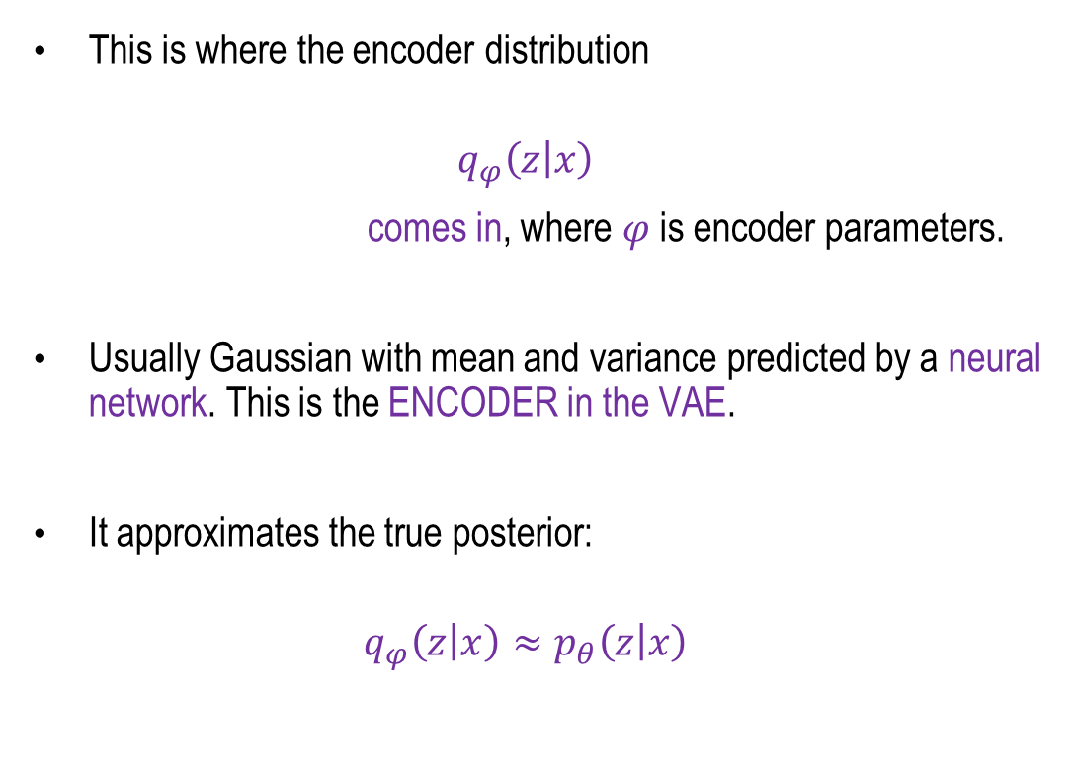




Variational Inference
This is where the encoder distribution
$$q_{φ}\left(z | x\right)$$
comes in, where $φ$ is encoder parameters.
Usually Gaussian with mean and variance predicted by a neural network. This is the ENCODER in the VAE.
It approximates the true posterior:
$$q_{φ}\left(z | x\right)≈p_{θ}\left(z | x\right)$$
$$X$$
$$q_{ϕ}(z|x)$$
Probabilistic Encoder
$$N(μ_{x},σ_{x})$$
$$μ_{x}σ_{x}$$
p(z|x)
Sampled
z ~ p(z|x)
$$Z\sim N(μ_{x},σ_{x})$$
Probabilistic
Decoder
$$p_{θ}(x|z)$$
$$\hat{X}=d(z)$$

Slide 6



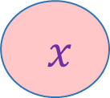


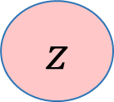


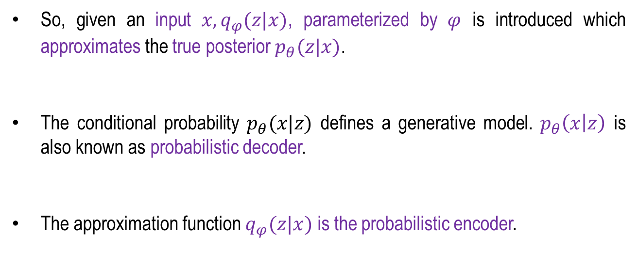
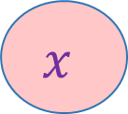

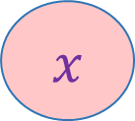

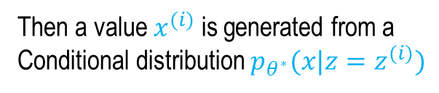

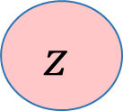


Variational Auto-Encoder
So, given an input $x,q_{φ}(z|x)$, parameterized by $φ$ is introduced which approximates the true posterior $p_{θ}(z|x)$.
The conditional probability $p_{θ}(x|z)$ defines a generative model. $p_{θ}\left(x | z\right)$ is also known as probabilistic decoder.
The approximation function $q_{φ}(z|x)$ is the probabilistic encoder.
$$x$$
$$φ$$
$$p_{θ}(x|z)$$
$$q_{φ}(z|x)$$
$$z$$
$$p_{θ}(x)$$
$$p_{θ}(z)$$
$$z\sim 𝒩(0,1)$$
$$x$$
$q_{φ}(z|x)$
$$z$$
  $$p_{θ}(x|z)$$
$$x$$
Then a value $x^{(i)}$ is generated from a Conditional distribution $p_{θ^{∗}}(x|z=z^{(i)})$
Probabilistic Encoder
Probabilistic Decoder
  $$p_{θ}(z)$$
$$θ$$
  $$p_{θ}(x)$$
$$θ$$
Concept: Fei-Fei Li, Ehsan Adeli, Generative Modelling, Stanford Lecture, 2024
Weng, Lilian. (2018). From Autoencoder to Beta-VAE, Lil’Log. "https://lilianweng.github.io/posts/2018-08-12-vae/"

Slide 7

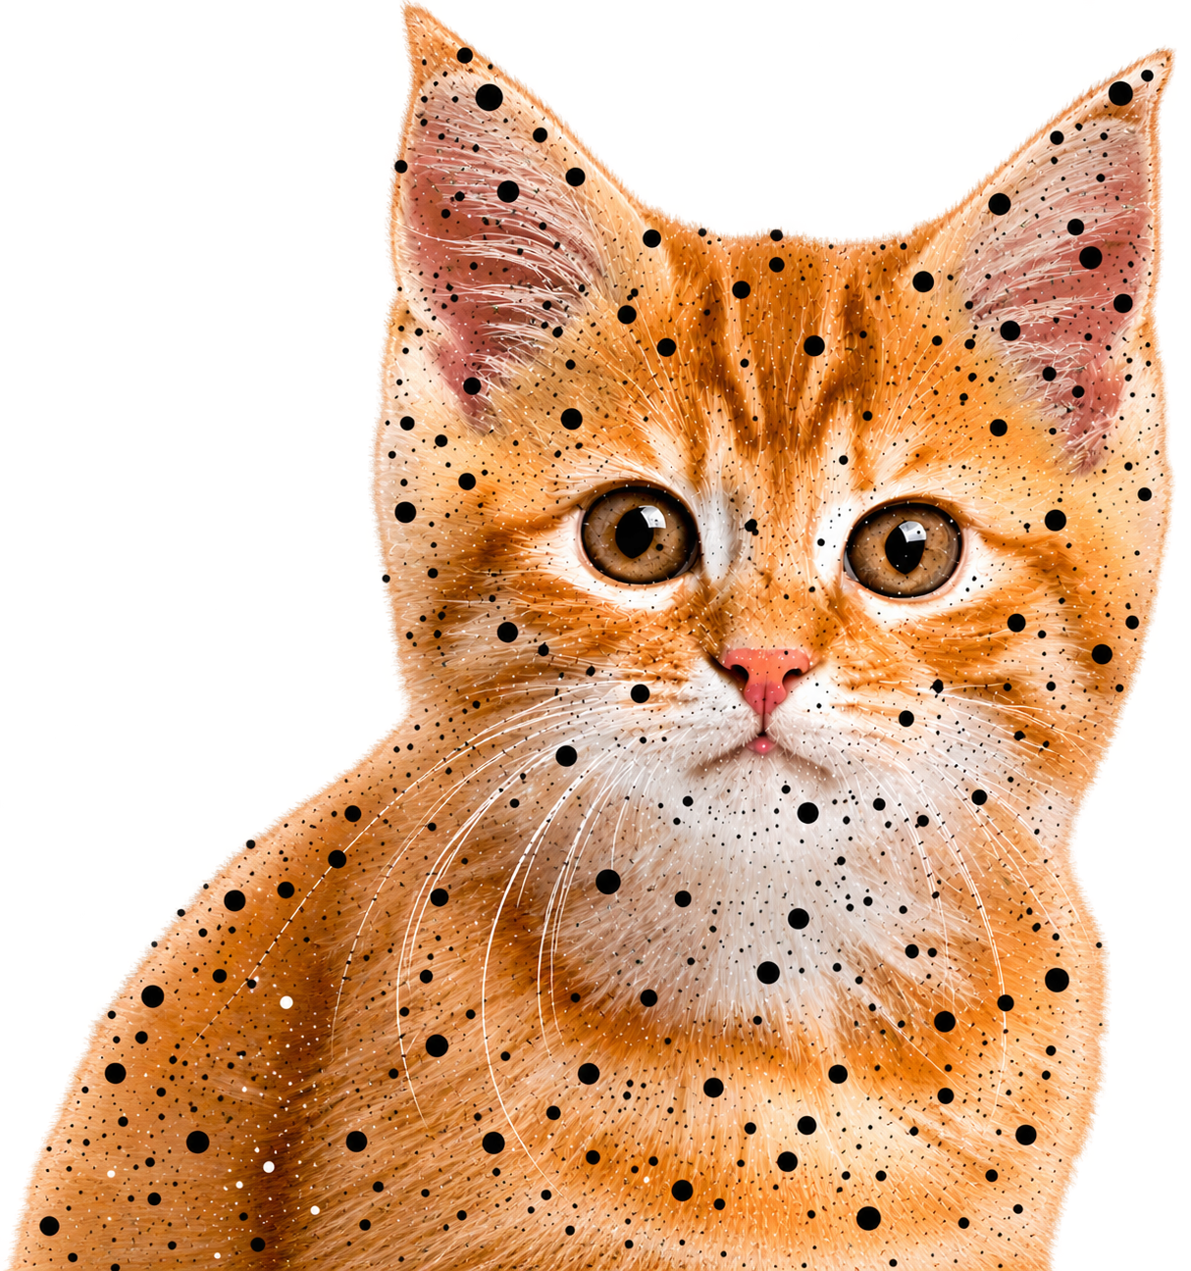




Example: Auto-Encoder
Input ($x$)
An ideal auto-encoder will learn the descriptive attributes of image like smile, hat, hair, eye etc.
In the above example, these attributes are described with a single value.
Encoder
$$P(z|x)$$
eye
ear
nose
…
color
0.2
0.8
0.3
…
0.7
Latent Attributes (z)
$$P(\hat{x}|z)$$
Decoder
Reconstructed Input ($\hat{x}$)
Concept: Fei-Fei Li, Ehsan Adeli, Generative Modelling, Stanford Lecture, 2024
Figure Source: Song, Chunlin & Sudirman, Sud & Merabti, Madjid. (2010). A Spatial and Frequency Domain Analysis of the Effect of Removal Attacks on Digital Image Watermarks.

Slide 8
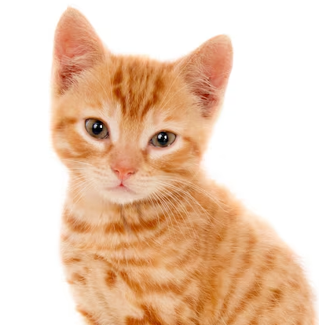




Example: Variational Auto-Encoder
Input ($x$)
In a Variational Autoencoder (VAE), each latent attribute is represented not as a fixed value but as a probability distribution.
This probabilistic representation allows the model to sample different values from the latent distributions and pass them through the decoder to generate images that exhibit similar characteristics to those in the training data.
Unlike a traditional autoencoder, where the primary objective is to reconstruct the input image, a VAE can generate entirely new images that may not have existed in the training dataset.
Thus, the VAE is not limited to reconstruction; it learns a continuous and structured latent space from which new, plausible samples can be generated, giving it its inherently generative nature.
Encoder
$$P(z|x)$$
eye
ear
nose
…
color
Latent Attributes (z)
$$P(\hat{x}|z)$$
Decoder
Generated Input ($\hat{x}$)
Concept: Fei-Fei Li, Ehsan Adeli, Generative Modelling, Stanford Lecture, 2024
Figure Source: Song, Chunlin & Sudirman, Sud & Merabti, Madjid. (2010). A Spatial and Frequency Domain Analysis of the Effect of Removal Attacks on Digital Image Watermarks.

Slide 9
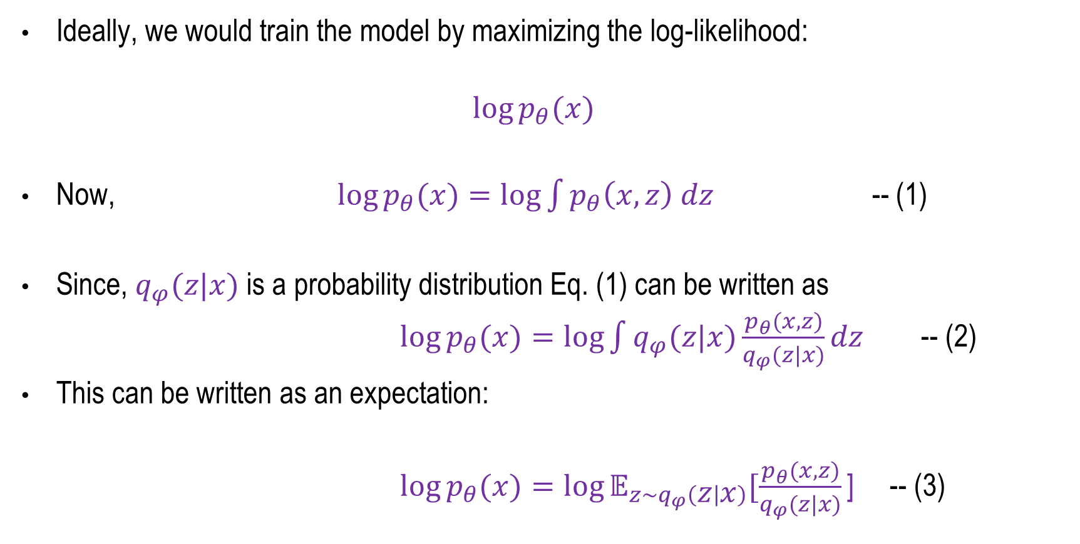
Evidence Lower Bound (ELBO)
Ideally, we would train the model by maximizing the log-likelihood:
$$\log{p_{θ}(x)}$$
Now, $\log{p_{θ}(x)}=\log{\int{p_{θ}\left(x,z\right) dz }}$ -- (1)
Since, $q_{φ}(z|x)$ is a probability distribution Eq. (1) can be written as
$\log{p_{θ}(x)}=\log{\int{q_{φ}(z|x)\frac{p_{θ}(x,z)}{q_{φ}(z|x)}}}dz$ -- (2)
This can be written as an expectation:
$\log{p_{θ}(x)}=\log{𝔼_{z\sim q_{φ}\left(z | x\right)}[\frac{p_{θ}(x,z)}{q_{φ}(z|x)}\text{]}}$ -- (3)

Slide 10
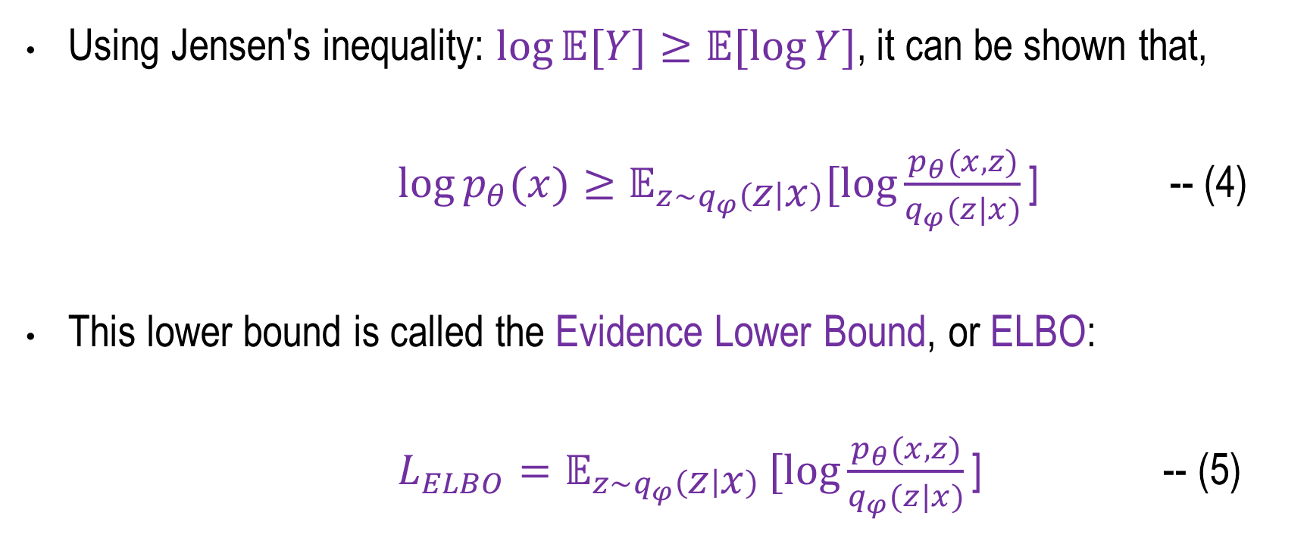
Evidence Lower Bound (ELBO)
Using Jensen's inequality: $\log{𝔼[Y]≥𝔼[\log{Y}]}$, it can be shown that,
$\log{p_{θ}(x)}≥𝔼_{z\sim q_{φ}\left(z | x\right)}[\log{\frac{p_{θ}(x,z)}{q_{φ}(z|x)}\text{]}}$ -- (4)
This lower bound is called the Evidence Lower Bound, or ELBO:
$L_{ELBO}=𝔼_{z\sim q_{φ}\left(z | x\right)}[log{\frac{p_{θ}(x,z)}{q_{φ}(z|x)}\text{]}}$ -- (5)

Slide 11
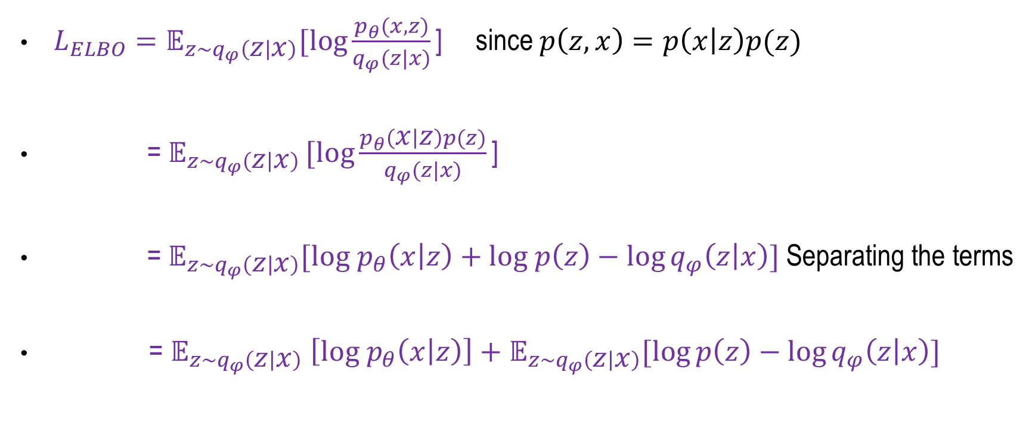
Expanding the ELBO
$L_{ELBO}=𝔼_{z\sim q_{φ}\left(z | x\right)}[\log{\frac{p_{θ}(x,z)}{q_{φ}(z|x)}\text{]}}$ since $p\left(z,x\right)=p\left(x | z\right)p(z)$
$\text{=}{ 𝔼}_{z\sim q_{φ}\left(z | x\right)}[log{\frac{p_{θ}\left(x | z\right)p(z)}{q_{φ}(z|x)}\text{]}}$
$\text{=} 𝔼_{z\sim q_{φ}\left(z | x\right)}[log{ p}_{θ}\left(x | z\right)+log p\left(z\right)−\log{q_{φ}\left(z | x\right)}]$ Separating the terms
$\text{= }𝔼_{z\sim q_{φ}\left(z | x\right)}$ $\left[log{ p}_{θ}\left(x | z\right)\right]+𝔼_{z\sim q_{φ}\left(z | x\right)}[\log{p\left(z\right)−\log{q_{φ}\left(z | x\right)]}}$

Slide 12
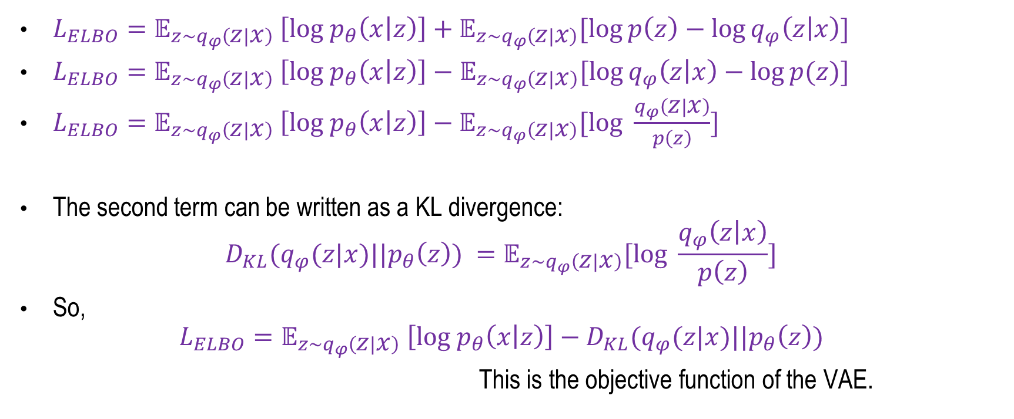
Expanding the ELBO
${L_{ELBO}=𝔼}_{z\sim q_{φ}\left(z | x\right)}$ $\left[log{ p}_{θ}\left(x | z\right)\right]+𝔼_{z\sim q_{φ}\left(z | x\right)}[\log{p\left(z\right)−\log{q_{φ}\left(z | x\right)]}}$
${L_{ELBO}=𝔼}_{z\sim q_{φ}\left(z | x\right)}$ $\left[log{ p}_{θ}\left(x | z\right)\right]−$ $𝔼_{z\sim q_{φ}\left(z | x\right)}[\log{q_{φ}\left(z | x\right)−\log{p(z)}]}$
${L_{ELBO}=𝔼}_{z\sim q_{φ}\left(z | x\right)}$ $\left[log{ p}_{θ}\left(x | z\right)\right]−𝔼_{z\sim q_{φ}\left(z | x\right)}[log \frac{q_{φ}\left(z | x\right)}{p\left(z\right)}]$
The second term can be written as a KL divergence:
$$D_{KL}(q_{φ}(z|x)||p_{θ}\left(z\right)) =𝔼_{z\sim q_{φ}\left(z | x\right)}[log \frac{q_{φ}\left(z | x\right)}{p\left(z\right)}]$$
So,
$$L_{ELBO}=𝔼_{z\sim q_{φ}\left(z | x\right)} \left[log{ p}_{θ}\left(x | z\right)\right]−D_{KL}(q_{φ}(z|x)||p_{θ}\left(z\right))$$
This is the objective function of the VAE.

Slide 13
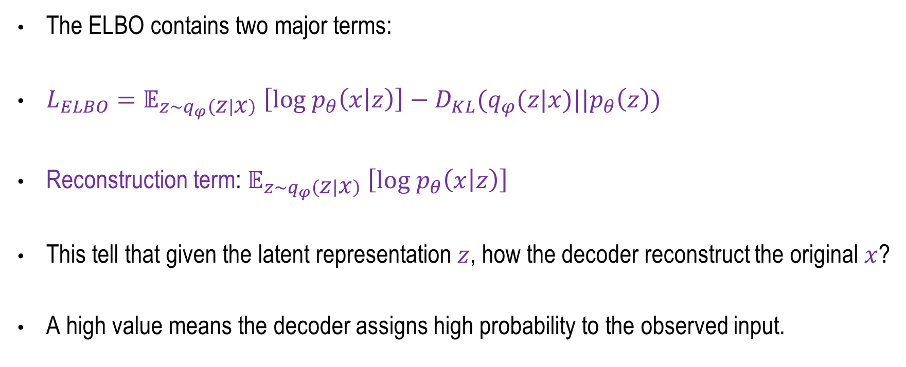
The two components of the VAE objective
The ELBO contains two major terms:
$L_{ELBO}=𝔼_{z\sim q_{φ}\left(z | x\right)} \left[log{ p}_{θ}\left(x | z\right)\right]−D_{KL}(q_{φ}(z|x)||p_{θ}\left(z\right))$
Reconstruction term: $𝔼_{z\sim q_{φ}\left(z | x\right)} \left[log{ p}_{θ}\left(x | z\right)\right]$
This tell that given the latent representation $z$, how the decoder reconstruct the original $x$?
A high value means the decoder assigns high probability to the observed input.
Reconstruction / Likelihood term
KL Regularization

Slide 14
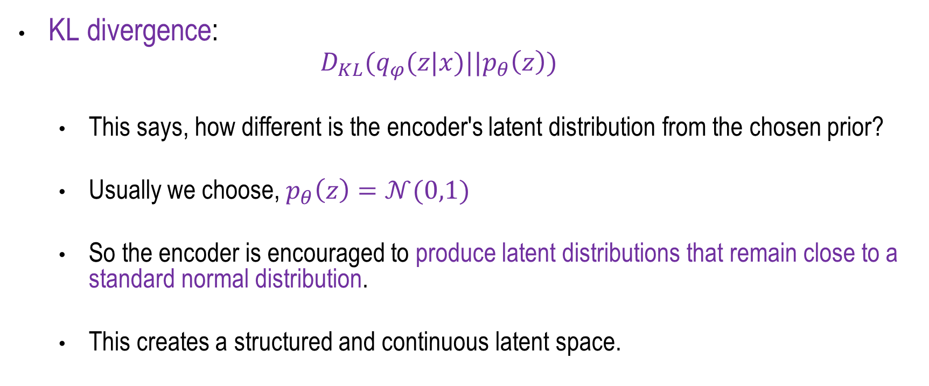
The two components of the VAE objective
KL divergence:
  $$D_{KL}(q_{φ}(z|x)||p_{θ}\left(z\right))$$
  This says, how different is the encoder's latent distribution from the chosen prior?
  Usually we choose, $p_{θ}\left(z\right)=𝒩(0,1)$
  So the encoder is encouraged to produce latent distributions that remain close to a standard normal distribution.
  This creates a structured and continuous latent space.

Slide 15
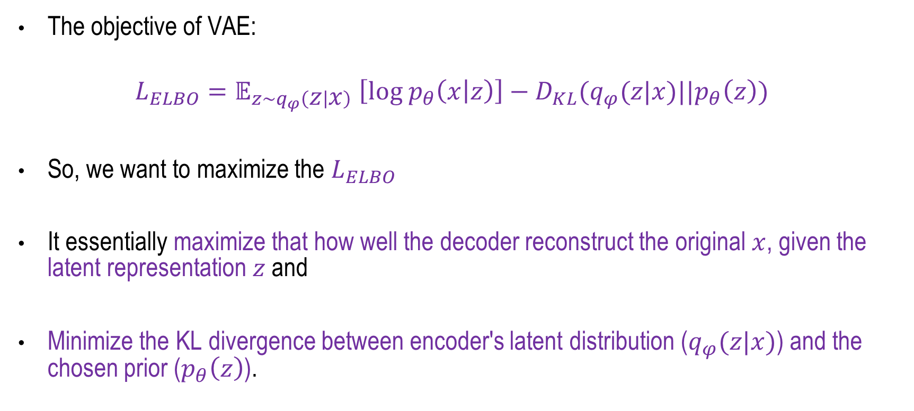
VAE Loss
The objective of VAE:
$$L_{ELBO}=𝔼_{z\sim q_{φ}\left(z | x\right)} \left[log{ p}_{θ}\left(x | z\right)\right]−D_{KL}(q_{φ}(z|x)||p_{θ}\left(z\right))$$
So, we want to maximize the $L_{ELBO}$
It essentially maximize that how well the decoder reconstruct the original $x$, given the latent representation $z$ and
Minimize the KL divergence between encoder's latent distribution ($q_{φ}(z|x)$) and the chosen prior ($p_{θ}\left(z\right)$).

Slide 16
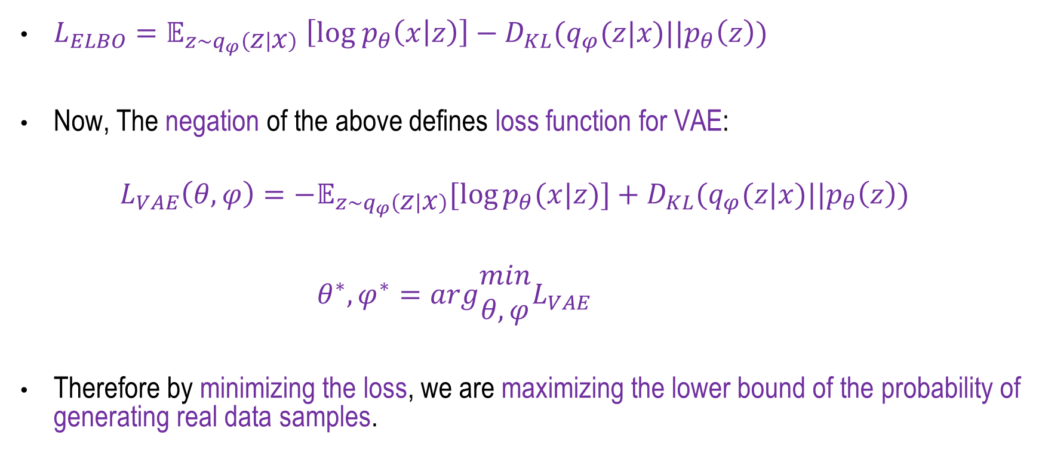
VAE Loss
$L_{ELBO}=𝔼_{z\sim q_{φ}\left(z | x\right)} \left[log{ p}_{θ}\left(x | z\right)\right]−D_{KL}(q_{φ}(z|x)||p_{θ}\left(z\right))$
Now, The negation of the above defines loss function for VAE:
$$L_{VAE}\left(θ,φ\right)=−𝔼_{z\sim q_{φ}\left(z | x\right)}[\log{p_{θ}(x|z)]}+D_{KL}(q_{φ}(z|x)||p_{θ}\left(z\right))$$
$θ^{∗},φ^{∗}=arg\begin{matrix}min \\ θ,φ\end{matrix}L_{VAE}$
Therefore by minimizing the loss, we are maximizing the lower bound of the probability of generating real data samples.
Weng, Lilian. (2018). From Autoencoder to Beta-VAE, Lil’Log. "https://lilianweng.github.io/posts/2018-08-12-vae/"

Slide 17
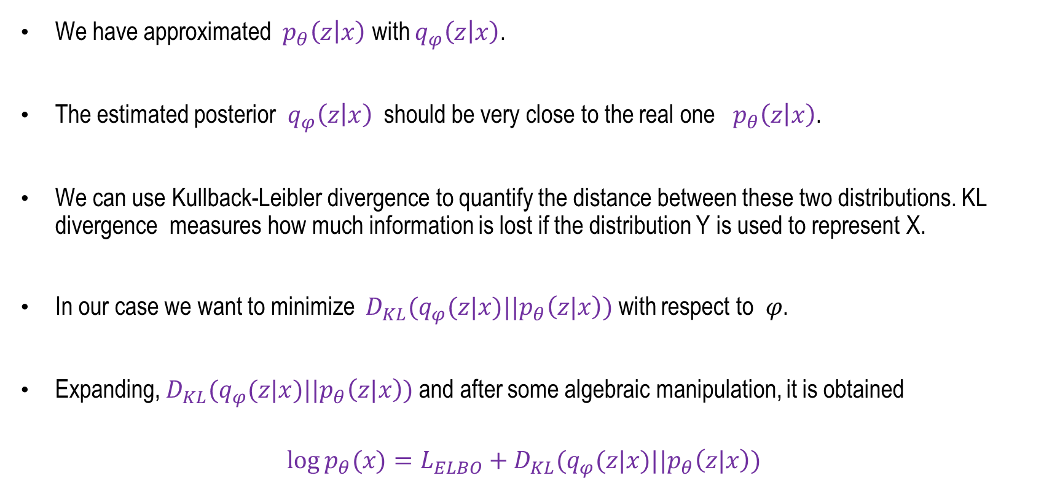
ELBO and Posterior Approximation
We have approximated ${ p}_{θ}\left(z | x\right)$ with $q_{φ}\left(z | x\right)$.
The estimated posterior $q_{φ}\left(z | x\right)$ should be very close to the real one ${ p}_{θ}\left(z | x\right)$.
We can use Kullback-Leibler divergence to quantify the distance between these two distributions. KL divergence measures how much information is lost if the distribution Y is used to represent X.
In our case we want to minimize $D_{KL}(q_{φ}(z|x)||p_{θ}\left(z|x\right))$with respect to 𝜑.
Expanding, $D_{KL}(q_{φ}(z|x)||p_{θ}\left(z|x\right))$and after some algebraic manipulation, it is obtained
$$\log{p_{θ}(x)}=L_{ELBO}+D_{KL}(q_{φ}(z|x)||p_{θ}\left(z|x\right))$$

Slide 18
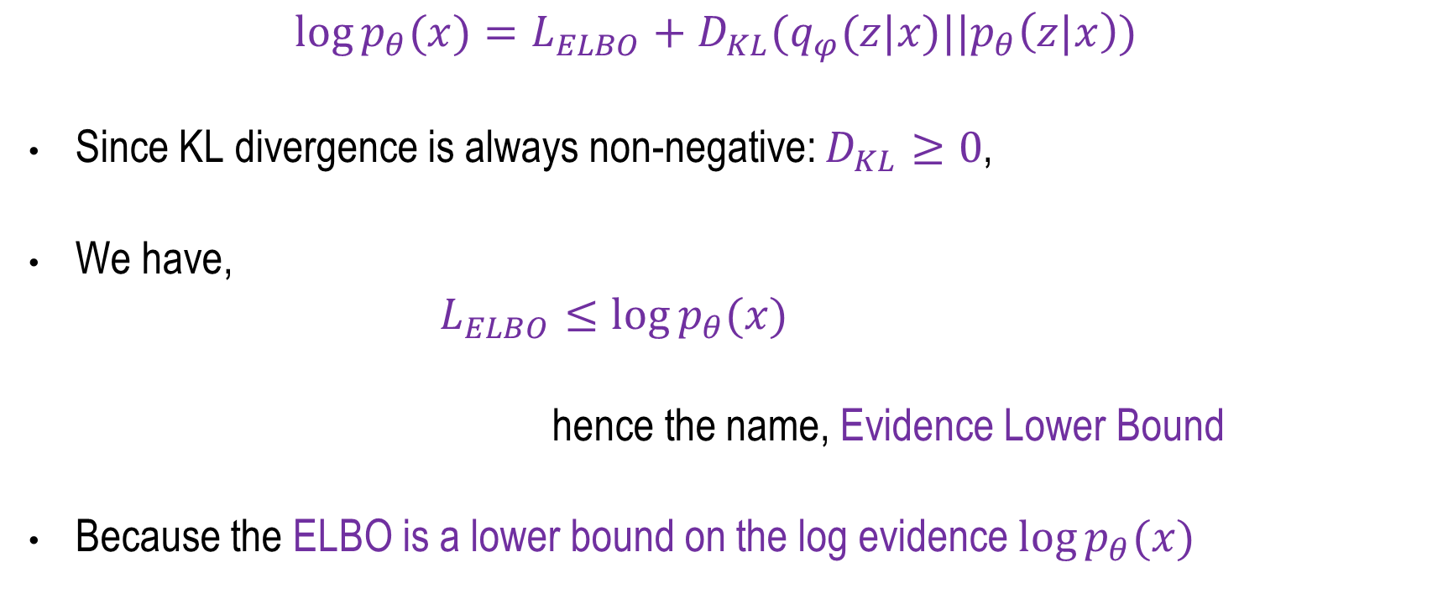
ELBO and Posterior Approximation
$$\log{p_{θ}(x)}=L_{ELBO}+D_{KL}(q_{φ}(z|x)||p_{θ}\left(z|x\right))$$
Since KL divergence is always non-negative: $D_{KL}≥0$,
We have,
$L_{ELBO}≤\log{p_{θ}(x)}$
hence the name, Evidence Lower Bound
Because the ELBO is a lower bound on the log evidence $\log{p_{θ}(x)}$

Slide 19
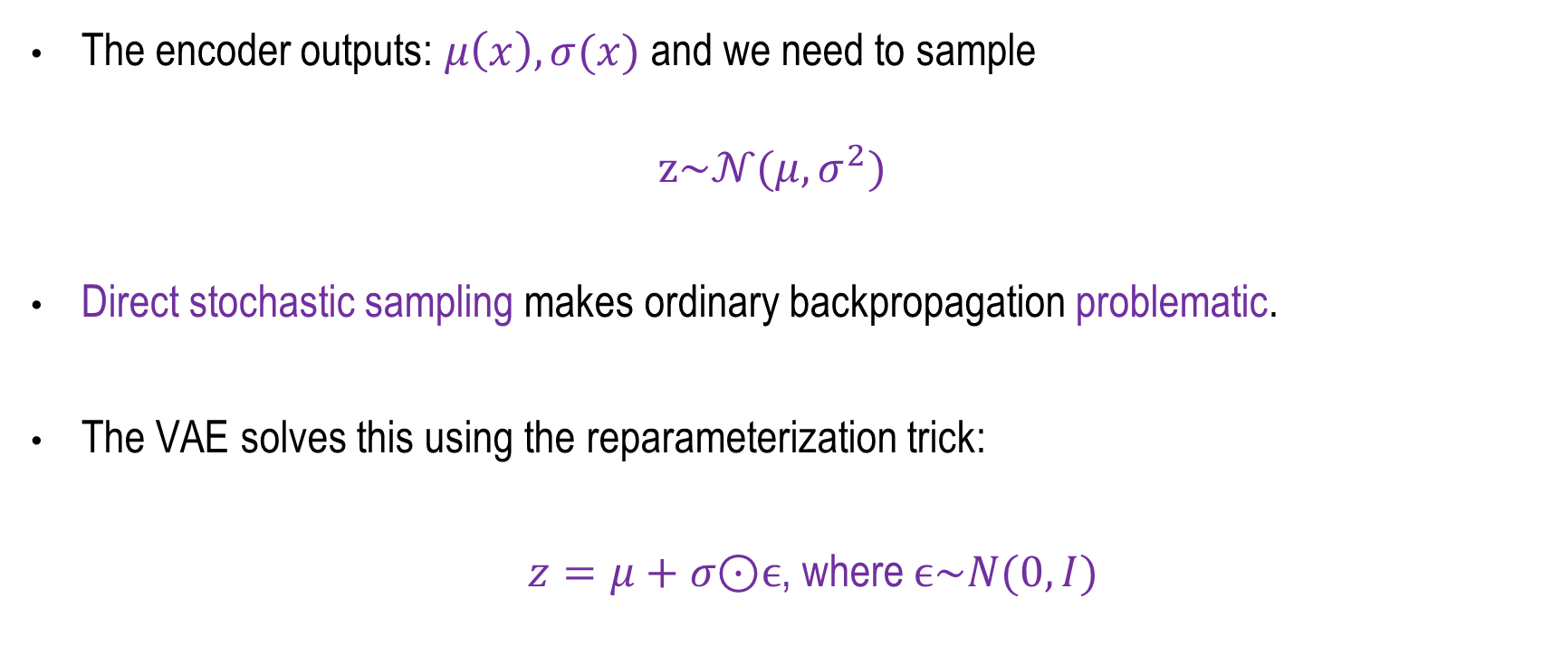
The Reparameterization Trick
The encoder outputs: $μ\left(x\right),σ(x)$and we need to sample
$$z\sim 𝒩(μ,σ^{2})$$
Direct stochastic sampling makes ordinary backpropagation problematic.
The VAE solves this using the reparameterization trick:
$z=μ+σ\text{⊙}ϵ$, where $ϵ\sim N(0,I)$

Slide 20
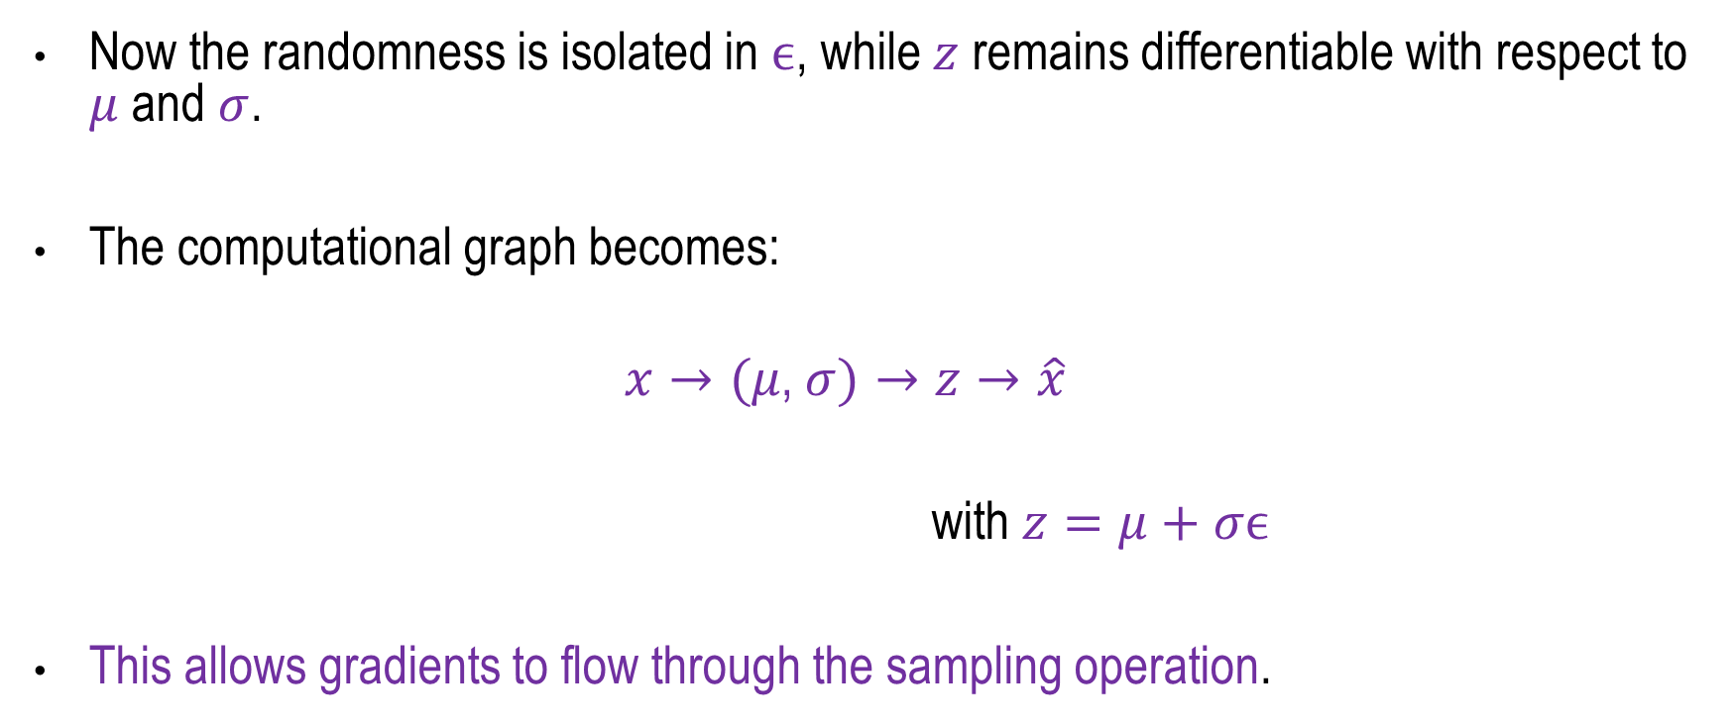
The Reparameterization Trick
Now the randomness is isolated in $ϵ$, while $z$ remains differentiable with respect to $μ$ and $σ$.
The computational graph becomes:
$$x→(μ\text{,} σ)→z→\hat{x}$$
with $z=μ+σϵ$
This allows gradients to flow through the sampling operation.

Slide 21
Why KL Divergence is used in VAE Loss?
Regularizes latent space
Prevents overfitting
Ensures smooth interpolation
Makes sampling possible

Slide 22
Applications
Image generation
Anomaly detection
Drug discovery
Representation learning
Semi-supervised learning

Slide 23
Summary
Variational Inference
Evidence Lower Bound (ELBO)
VAE objective Function
VAE Loss Function
ELBO and posterior approximation
The Reparameterization Trick
Vision Applications

Slide 24
Diffusion Models
Next
Lecture 10: Part 1
Generative AI for Computer Vision

